Slide 1

Mobile Price Prediciton
Feature Extraction & Price Prediction — Project Report
Subtitle: End-to-end workflow: data cleaning → feature extraction → modeling → recommendations
created by : Prashant Singh
Date: 14.11.2025

Slide 2
Slide 2 — Project outline
Slide title: Project Outline
Problem statement & objective
Data loading & cleaning steps
Exploratory data analysis (uni/bi/multivariate)
Feature engineering & encoding
Model building and evaluation
Feature importance & recommendations

Slide 3
Slide 3 — Problem statement & objective
Slide title: Problem & Objective
Content:
01
Problem: Predict the retail price of mobile phones using device specifications.
02
Objective: Build an accurate regression model and identify the features that most strongly influence price to guide pricing and marketing decisions.
03

Slide 4
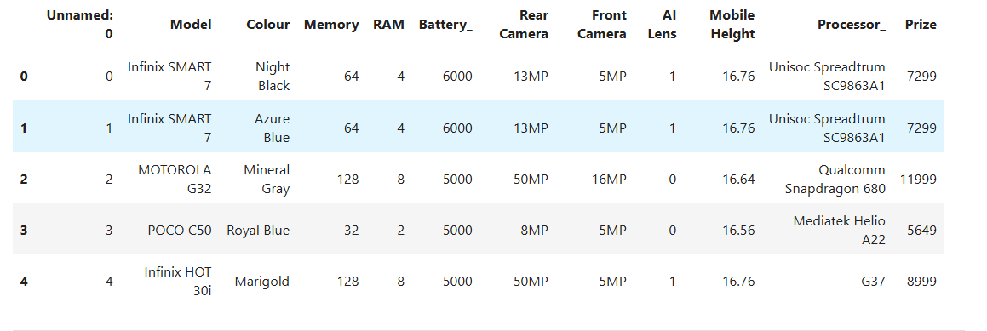
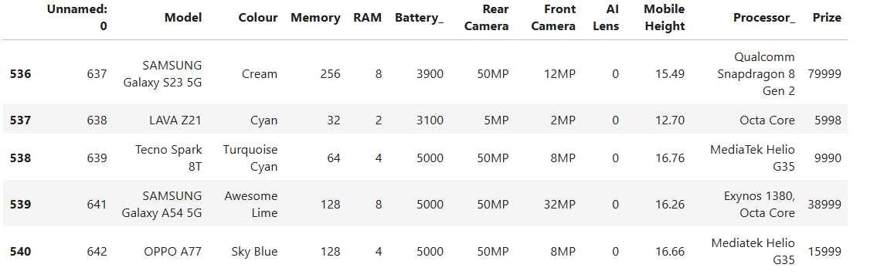
Slide 4 — Data overview
Slide title: Data Overview
The dataset contains device-level records with fields such as: Model, Colour, Memory (GB), RAM (GB), Battery (mAh), Rear Camera, Front Camera, AI Lens flag, Mobile Height, Processor, and Price.

Slide 5
Slide 5 — Data loading & cleaning (what we did)
Data Loading & Cleaning :
Loaded data from Processed_Flipdata.xlsx.
Removed extraneous index/Unnamed columns and trimmed whitespace from text fields.
Converted textual numeric fields (e.g., "50MP") to numeric megapixel values.
  Converted battery and memory/RAM to numeric types.
Renamed inconsistent column (Prize → Price) for clarity.
Handled missing values: numeric columns imputed with median; categorical fields filled with Unknown.

Slide 6
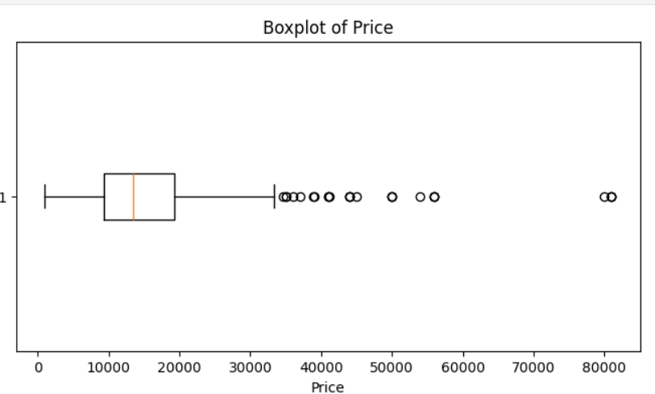
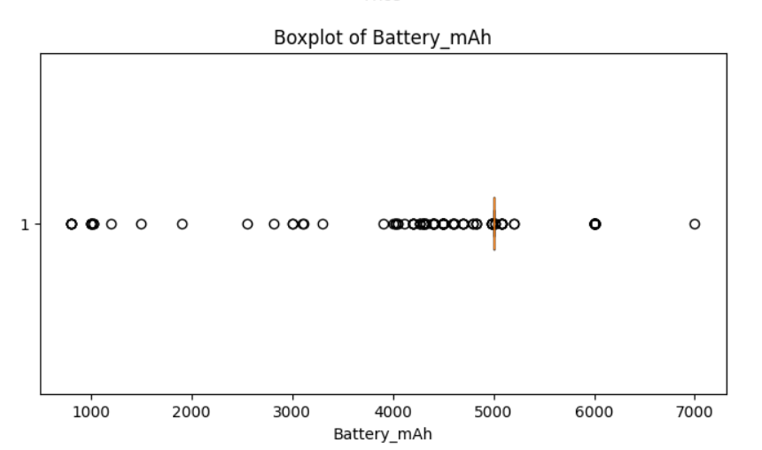
Slide 6 — Univariate analysis
Univariate Analysis — Key Distributions
Observations: price distribution is [skewed/normal — insert your observation]; identify any strong outliers.
Examined distributions and outliers for numeric features: Price, Battery, RAM, Memory, Rear_MP,
Front_MP, Mobile Height.

Slide 7
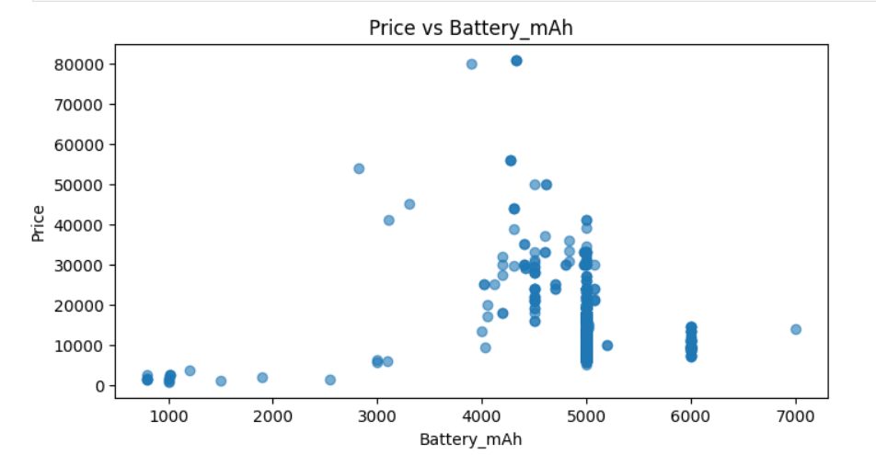
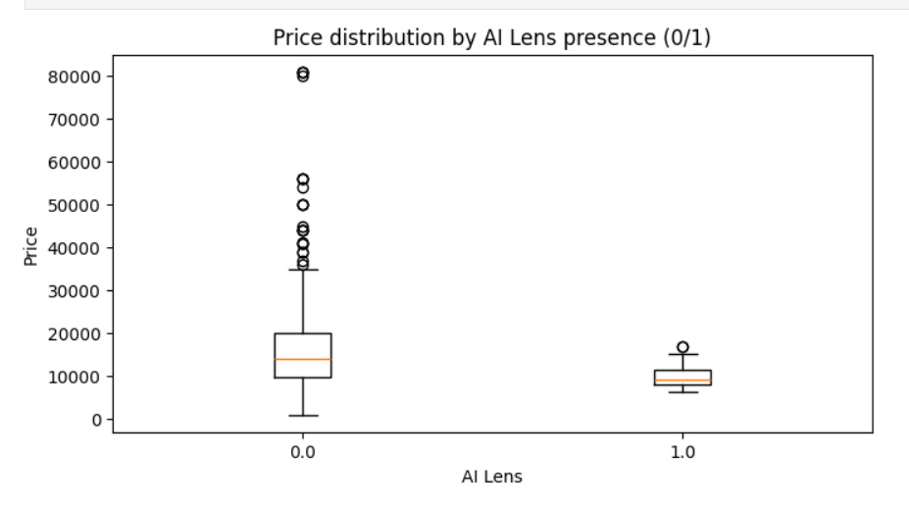
Bivariate analysis (relationships)
Bivariate Analysis — Price vs Features
Scatter plots to check simple relationships: Price vs Battery, Price vs RAM, Price vs Memory, Price vs Camera MP.
Boxplots to compare price by categorical flags (e.g., AI Lens presence).
Observations: e.g., “Higher RAM and higher camera MP generally correlate with higher price.”

Slide 8
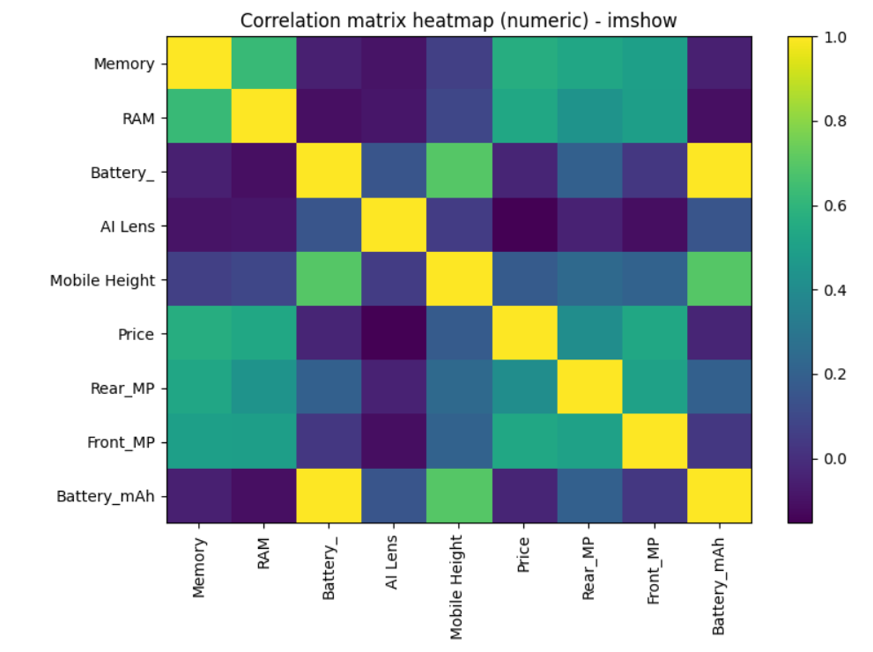
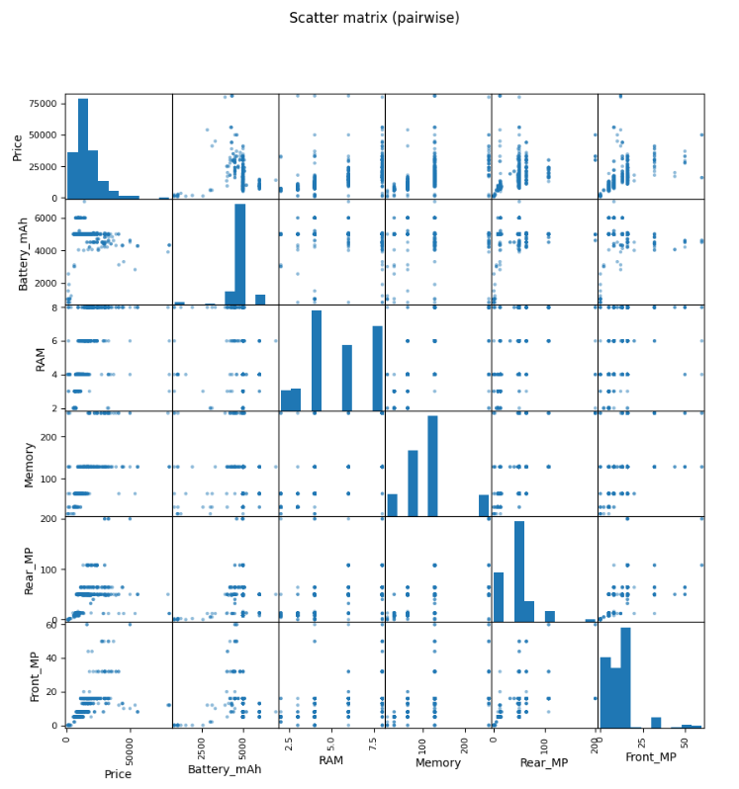
Multivariate analysis (correlations & pairwise)
Multivariate Analysis — Correlations
Computed correlation matrix for numeric features to identify strongest linear relationships with Price.
Key correlated features (descending): Memory, Front_MP, RAM, Rear_MP, etc. (insert your top 3–6).

Slide 9
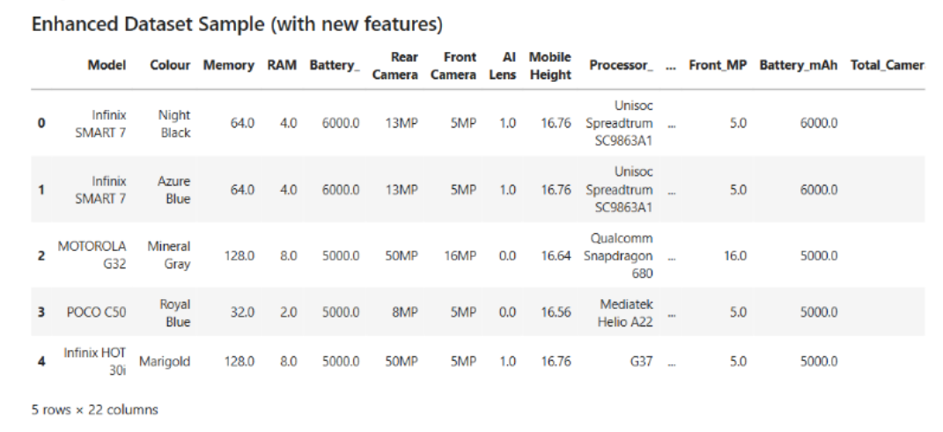
Feature engineering (what we created)
Total_Camera_MP = Rear_MP + Front_MP — captures combined camera capability.
Rear_to_Front_Ratio = Rear_MP / Front_MP — camera emphasis indicator.
Battery_per_RAM = Battery_mAh / RAM — battery capacity per GB of RAM (proxy for endurance per performance).
Model_freq = frequency encoding of Model (model popularity).
Processor_brand = first token of processor text (e.g., Qualcomm, MediaTek).

Slide 10

Feature encoding & selection (brief)
Encoding & Feature Selection
Frequency-encoding used for Model to avoid high-dimensional one-hot for many models.One-hot encoding for Processor_brand and Colour limited to top categories; others grouped as Other.Candidate features selected for modeling: Battery_mAh, RAM, Memory, Rear_MP, Front_MP, Total_Camera_MP, Rear_to_Front_Ratio, Battery_per_RAM, Model_freq plus selected dummies.

Slide 11

Modeling approach
Train/test split: 80% train / 20% test (random_state=42).
Models trained:
Linear Regression (baseline)
Random Forest Regressor (non-linear ensemble)
Evaluation metrics used: MAE, RMSE, R².

Slide 12
Model evaluation (results)
Model Evaluation — Results Summary
Linear Regression — MAE: [value], RMSE: [value], R²: [value].
Random Forest — MAE: [value], RMSE: [value], R²: [value] (best performing model).
Observations: Random Forest reduced error by [x%] vs baseline and achieved strong R² indicating good fit.

Slide 13



Feature importance & interpretation
Feature Importance & Insights
Extracted feature importances from Random Forest and permutation importance for robustness.
Top predictors: Front_MP, Battery_mAh, Total_Camera_MP, Battery_per_RAM, Memory, RAM.
Interpretation: camera specs and battery are strong price drivers — products with better camera and battery tend to command higher price.

Slide 14
Recommendations
Recommendations for Business / Product Team
Highlight Battery, Camera, and RAM heavily in product listings and marketing for higher-priced models.
Use Model_freq and Processor_brand insights to guide inventory and promotional focus on popular/valuable models.
Collect additional useful fields (screen type, refresh rate, warranty, brand reputation, launch date) to further improve model accuracy.
Run hyperparameter tuning (GridSearch/CV) and test advanced models (XGBoost/LightGBM) to squeeze out better performance.

Slide 15
Limitations & next steps
Limitations & Next Steps
Limitations: missing features (screen tech, brand trust), potential labeling inconsistency, unobserved market factors (discounts, region).
Next steps: hyperparameter tuning, cross-validation, external validation set, deploy model as an API for real-time pricing suggestions.
Thank You

